Slide 1
F1 Race Prediction for Media Company

Slide 2
Overview

Slide 3
Objective: Analyze Formula 1 race data to understand factors influencing race outcomes and provide insights for media companies.

Slide 4
Introduction

Slide 5

Formula 1 (a.k.a. F1 or Formula One) is the highest class of single-seater auto racing sanctioned by the Fédération International de Automobile (FIA) and owned by the Formula One Group. The FIA Formula One World Championship has been one of the premier forms of racing around the world since its inaugural season in 1950. The word "formula" in the name refers to the set of rules to which all participants' cars must conform. A Formula One season consists of a series of races, known as Grands Prix, which take place worldwide on purpose-built circuits and on public roads.

Slide 6
The datasets are available
race_details.csv: Includes detailed race results for all Grand Prix tracks from 1950 until present.
race_summaries.csv: Includes summarized race results for all Grand Prix tracks from 1950 until present.
starting_grids.csv: Includes the starting grids for all Grand Prix tracks from 1950 until present.
sprint_grid.csv: Includes the starting grid for the sprint race on a Saturday. The sprint format was introduced in 2021 for three tracks (Silverstone, Monza and Interlagos). The result of the sprint race decides the starting grid for the main race on Sunday.
sprint_results.csv: Includes sprint race results all for all Grand Prix tracks from 2021 until present.
fastest_laps.csv: Includes fastest lap summaries for all Grand Prix tracks from 1950 until present.
fastestlaps_detailed.csv: Includes fastest lap details for all Grand Prix tracks from 1950 until present.
qualifyings.csv: Includes detailed race results for all Grand Prix tracks from 1950 until present.
practices.csv: Includes FP1/FP2/FP3 results for all Grand Prix tracks from 1986 until present.
pitstops.csv: Includes pitstop details for all Grand Prix tracks from 1994 until present.
team_details.csv: Includes team details for teams that drove from 1958 until present.
constructor_standings.csv: Includes team standings for all Grand Prix tracks from 1958 until present. Team awards have been awarded only since 1958.
driver_standings.csv: Includes driver standings for all Grand Prix tracks from 1950 until present.
driver_details.csv: Includes driver details for all races from 1950 until present

Slide 7
Datasets used
Race_details
Race_summaries
Pitstops
Driver_standings
Driver_details
Fastest_laps
Qualifyings

Slide 8
Data Cleaning/Pre-Processing

Slide 9
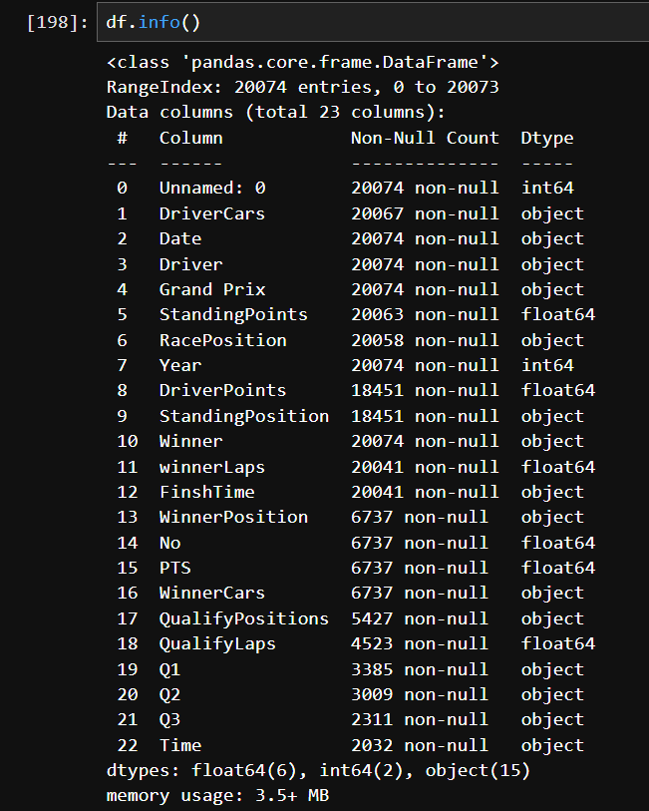
Data Information
Total columns:-23
Total rows:- 20074
Dtypes:- float64(64), int64(2),object(15)
Memory usage:- 3.5+MB

Slide 10
EDA[Exploratory Data Analysis]
Data size:- (20074, 23)
Remove unrelated columns:-
Rename columns :-
Duplicate data present?
Remove duplicate data
Remove null values

Slide 11
EDA[Exploratory Data Analysis]
Checked Outliers
Reset the index
Checked unique value in “ Race_Position “
DNC: Stands for Did Not Compete.
DNS: Stands for Did Not Start.
EXR: Stands for Excluded from Race.
DSQ: Stands for Disqualifie.
DNF: did not finish.
Replace all the value with 0 those value has no meaning the race.
Type casting :-

Slide 12
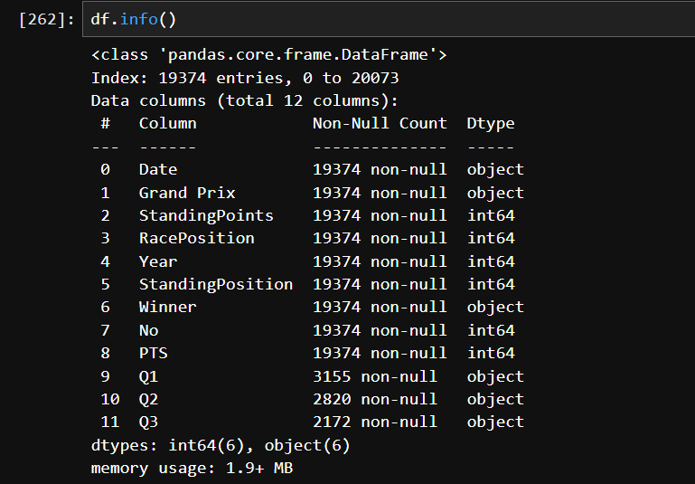
Data Information After Perform EDA
Total columns:-12
Total rows:- 19374
Dtypes:- int64(6),object(6)
Memory usage:- 1.9+MB

Slide 13
Transforming Data

Slide 14
Why do we need to transform data?
In the dataset, the first year for which there is information about qualifying is 1994.
The closest to the current format of qualifying was first introduced in 1996.
It differs from the current system in limiting drivers to 12 laps only, while currently there are no limits on the number of laps to be completed.
Huge changes and a lot of variation were introduced to the qualifying format between 2003 and 2005.

Slide 15
Why do we need to transform data?
Starting with the year 2006, a three-part system of qualifying was introduced.
These days, drivers are limited by the time in which they have to complete the fastest lap they can.
After each qualifying round, 5 drivers with the worst lap times are eliminated, so only 10 advance to the final round (Q3).
For these reasons, we limit the data to 1996 - 2001 and 2006 - 2022. (For which we have the full quality information)

Slide 16
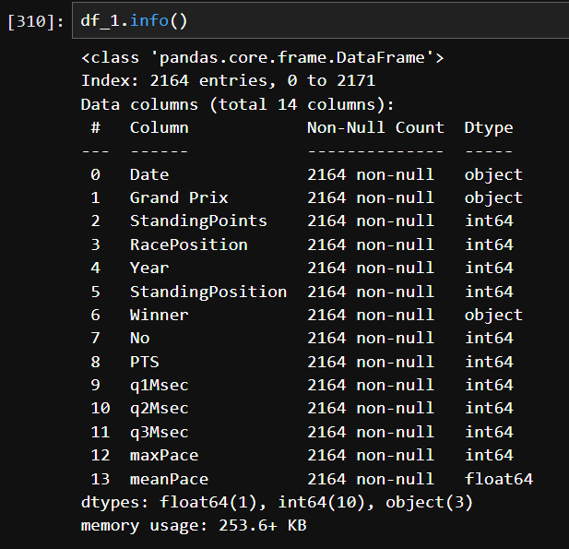
Data Information After Transforming Data
Total columns:-14
Total rows:- 2164
Dtypes:- float64(1),int64(6),object(6)
Memory usage:- 253.6+KB

Slide 17
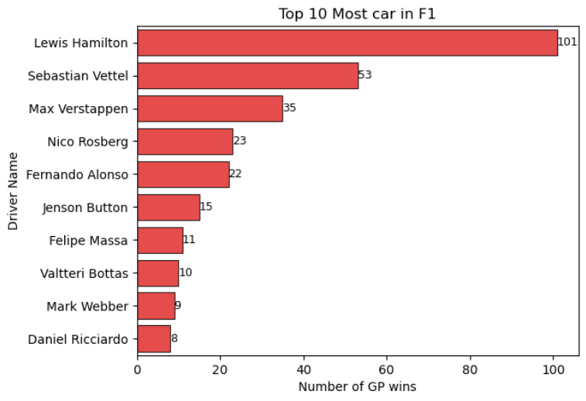
Top 10 Drivers Visualization Report

Slide 18
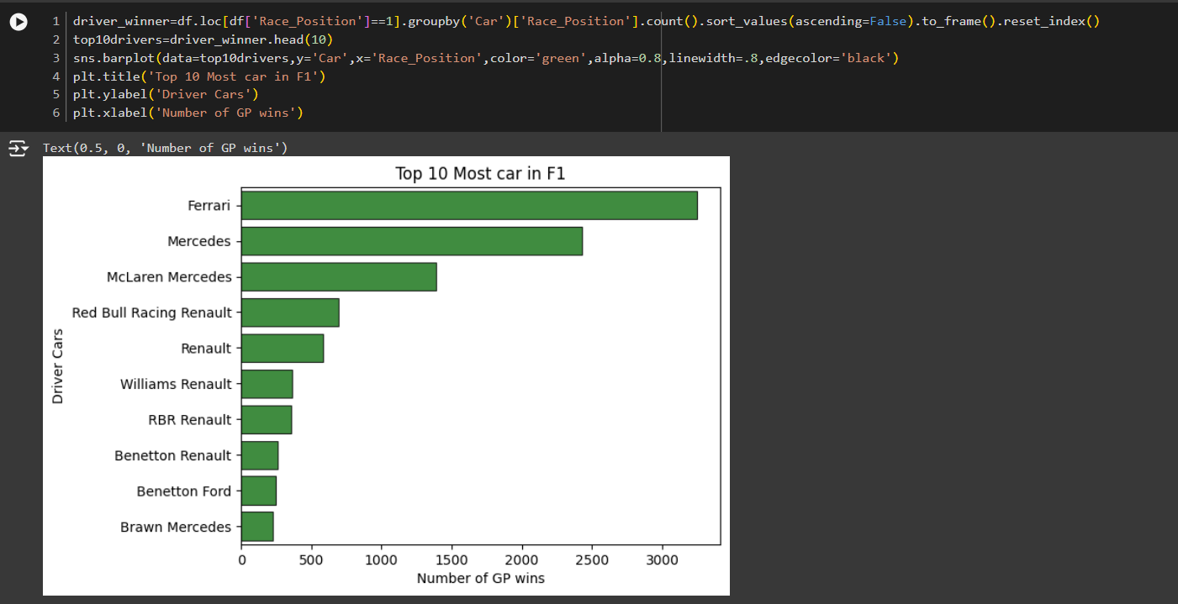
Top 10 Cars Visualization Report

Slide 19
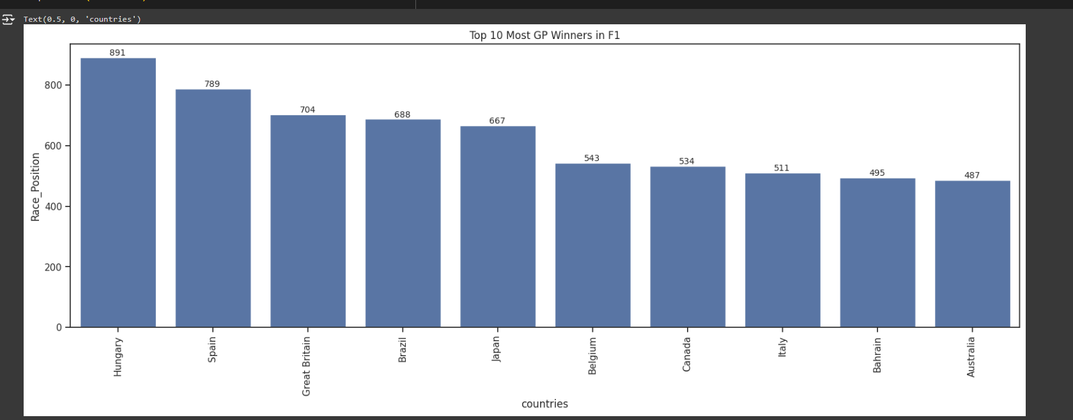
Top 10 Most GP Winners Countries in F1

Slide 20
Machine Learning Models
Comparison Of Classification Models Accuracy
* Logistic Regression Classification
* KNN Classification
* SVM Classification
* Naive Byes Classification
* Decision Tree Classification
* Random Forest Classification

Slide 21
Model Predication Approaches
First Approach:-
StandingPosition with RacePosition
XGBoost :-
Mean Accuracy - 0.9496321957060987
Test Accuracy: 0.9376
Naive Bayesian :-
Mean Accuracy: 0.9496311265075701
Test Accuracy: 0.9353
Logistic Regression :-
Mean Accuracy: 0.9505559832349672
Test Accuracy: 0.9376
SVM :-
Mean Accuracy: 0.9510178769994013
Test Accuracy: 0.9353
Decision Tree:-
Mean Accuracy: 0.9496311265075701
Test Accuracy: 0.9376
Random Forest :-
Mean Accuracy: 0.9491703019416644
Test Accuracy: 0.9376

Slide 22
Model Predication Approaches
Second Approach:-
Winner with StandingPosition
XGBoost :-
Mean Accuracy: 0.8604460696262082
Test Accuracy: 0.8568
Naive Bayesian:-
Mean Accuracy: 0.8650650072705501
Test Accuracy: 0.8568
Logistic Regression :-
Mean Accuracy: 0.8650650072705501
Test Accuracy: 0.8568
SVM :-
Mean Accuracy: 0.8650650072705501
Test Accuracy: 0.8568
Decision Tree:-
Mean Accuracy: 0.8604460696262082
Test Accuracy: 0.8568
Random Forest :-
Mean Accuracy: 0.8604460696262082
Test Accuracy: 0.8568

Slide 23
Model Predication Approaches
Third Approach:-
Winner with Years
XGBoost :-
Mean Accuracy: 0.44330467881276203
Test Accuracy: 0.8129
Naive Bayesian:-
Mean Accuracy: 0.753697288512531
Test Accuracy: 0.7667
Logistic Regression :-
Mean Accuracy: 0.6673231545633393
Test Accuracy: 0.8129
SVM :-
Mean Accuracy: 0.6973462492515611
Test Accuracy: 0.8129
Decision Tree:-
Mean Accuracy: 0.44330467881276203
Test Accuracy: 0.8129
Random Forest :-
Mean Accuracy: 0.44330467881276203
Test Accuracy: 0.8129

Slide 24
Conclusion:
Predictive Modeling Potential: The insights gained can be used to develop predictive models for race outcomes, enhancing viewer engagement and attracting sponsorships for media companies.
Data-Driven Storytelling: Media companies can leverage the analyzed data to create compelling narratives and visualizations, enriching the fan experience.
Future Directions: Further analysis could involve incorporating additional data sources, such as weather conditions and tire strategies, to refine predictive models.

Slide 25
Thank You!

